Slide 1
Scaling the right-angled triangle from the unit circle
Trigonometry

Slide 2
How our teaching resources are designed for the classroom

Slide 3
I can recognise the right-angled triangle within a unit circle and use proportion to scale to similar triangles.

Slide 4
The radius is any line segment that joins the centre of a circle to any part on its circumference.
The hypotenuse is the side of a right-angle triangle which is opposite the right angle.

Slide 5
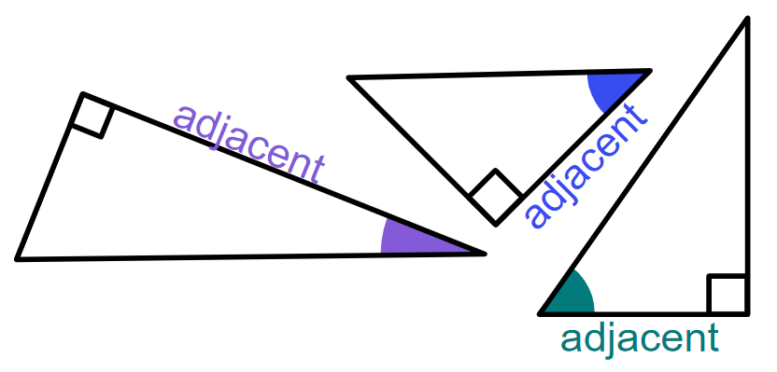
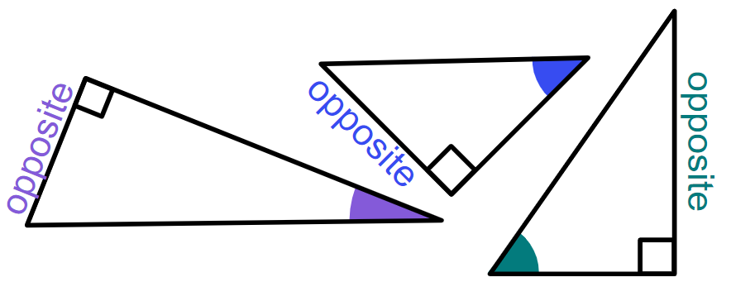
The adjacent side of a right-angled triangle is the side which is next to both the right angle and the marked angle.
The opposite side of a right-angled triangle is the side which is opposite the marked angle.
The trigonometric ratios are ratios between each pair of lengths in a right-angled triangle:
sin(θ°) = opposite cos(θ°) = adjacent tan(θ°) = opposite
hypotenuse hypotenuse adjacent

Slide 6

Scaling the right-angled triangle from the unit circle
Labelling sides of a right-angle triangle
Using sine and cosine from the unit circle
Using tangent from the unit circle

Slide 7
Labelling sides of a right-angled triangle
In the right angle below, one of the acute angles has been marked.
The hypotenuse is always the longest side.
We can refer to the other two sides of the triangle based on their position in relation to the marked angle.
The side which is opposite the acute interior angle that is marked in the triangle is called the ‘opposite’.
hypotenuse
opposite
The side which is next to both the right angle and the other marked interior angle is called the ‘adjacent’.
adjacent

Slide 8
Labelling sides of a right-angled triangle
The hypotenuse is always the longest side.
The lengths of the other two sides do not affect which way around the opposite and adjacent are labelled. These labels only depend on the position of the acute angle that has been marked.
hypotenuse
hypotenuse
opposite
opposite
adjacent
adjacent

Slide 9
Labelling sides of a right-angled triangle
The orientation of the triangle does not affect which way around the opposite and adjacent are labelled.
These labels only depend on the position of the acute angle that has been marked.
hypotenuse
hypotenuse
opposite
opposite
adjacent
adjacent

Slide 10

Labelling sides of a right-angled triangle
The opposite is always the shortest side of a right-angled triangle.
The side which is labelled opposite is always opposite the acute angle that is marked.
The side which is labelled opposite is always opposite the right angle.

Slide 11
Labelling sides of a right-angled triangle
Which side is the opposite in this triangle?
C
A
C
B
opposite

Slide 12
Labelling sides of a right-angled triangle
1) Label the sides of each triangle with the words ‘opposite’, ‘adjacent’ and ‘hypotenuse’. In parts (g) and (h), also mark the appropriate angle with θ.
a)
b)
c)
d)
θ
θ
θ
θ
e)
f)
g)
h)
θ
θ
adjacent
opposite

Slide 13
Labelling sides of a right-angled triangle
1) Label the sides of each triangle with the words ‘opposite’, ‘adjacent’ and ‘hypotenuse’. In parts (g) and (h), also mark the appropriate angle with θ.
a)
b)
c)
adjacent
d)
opposite
θ
hypotenuse
θ
hypotenuse
opposite
adjacent
hypotenuse
opposite
hypotenuse
adjacent
θ
θ
adjacent
opposite
e)
f)
g)
h)
adjacent
hypotenuse
adjacent
θ
opposite
θ
hypotenuse
θ
θ
hypotenuse
adjacent
hypotenuse
adjacent
opposite
opposite
opposite

Slide 14
Scaling the right-angled triangle from the unit circle
Labelling sides of a right-angle triangle
Using sine and cosine from the unit circle
Using tangent from the unit circle

Slide 15

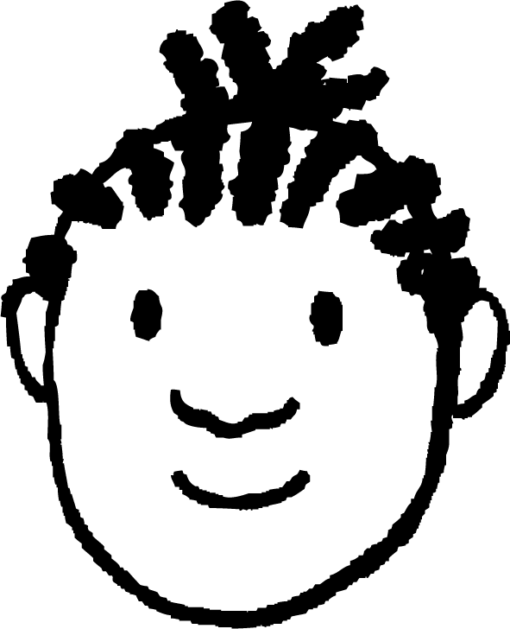
Using sine and cosine from a unit circle
The diagram shows a right-angled triangle inside the unit circle.
y
I have drawn a similar triangle.
1
They’re similar because they have the same angles.
(0.8, 0.6)
37°
5 cm
−1
O
1
x
Jacob
37°
−1
How does Jacob know it’s similar?

Slide 16
Using sine and cosine from a unit circle
For any right-angled triangle, a similar triangle can be made inside the unit circle.
y
1
θ°
θ°
−1
O
1
x
The first quadrant is the only part of the unit circle where θ° is equal to the interior angle of the triangle.
−1

Slide 17
Using sine and cosine from a unit circle
The sine of the angle, sin(θ), is the y-coordinate of the point where the radius has been rotated through that angle.
y
1
sin(θ)
opposite
1
hypotenuse
sin(θ)
θ°
θ°
O
1
x
For the triangle inside the first quadrant of the unit circle, the length of the opposite is equal to sin(θ).

Slide 18
Using sine and cosine from a unit circle
The cosine of the angle, cos(θ), is the x-coordinate of the point where the radius has been rotated through that angle.
y
1
sin(θ)
opposite
1
hypotenuse
sin(θ)
θ°
θ°
O
1
x
cos(θ)
cos(θ)
adjacent
For the triangle inside the unit circle, the length of the adjacent is equal to cos(θ).

Slide 19
Using sine and cosine from a unit circle
If θ and one of the edge lengths of a triangle is known, the others can be calculated by using the same proportions (ratios) as the triangle from the unit circle.
opposite
hypotenuse
1
sin(θ)
θ°
θ°
O
cos(θ)
adjacent

Slide 20
Using sine and cosine from a unit circle
If θ and one of the edge lengths of a triangle is known, the others can be calculated by using the same proportions (ratios) as the triangle from the unit circle.
Jacob’s example:
hypotenuse
× 0.6
opposite
× 0.6
opposite
5 cm
hypotenuse
3 cm
1
× 0.8
0.6
× 0.8
37°
37°
O
0.8
4 cm
adjacent
adjacent

Slide 21
Using sine and cosine from a unit circle
What is the value of y?
0.5
y
1
10 cm
0.87
y cm
0.87
5
60°
60°
O
1
x
8.7
0.5

Slide 22
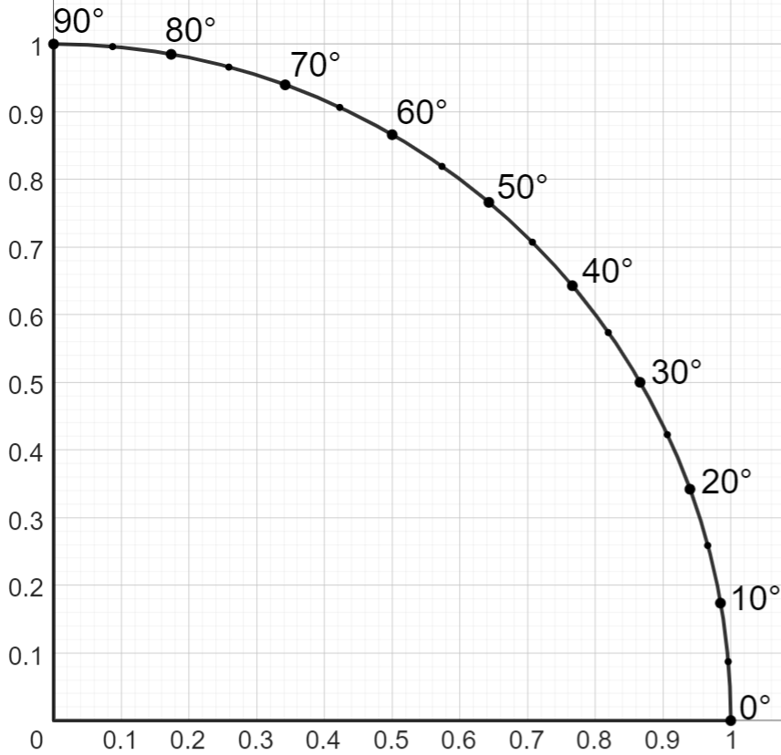
Using sine and cosine from a unit circle
sin(θ)
The diagram shows the sector of the unit circle that lies in the first quadrant.
The points around the circumference show the angle of rotation (θ) from the horizontal axis to the radius at each point.
Link to an interactive version: unit circle in first quadrant🖇
cos(θ)

Slide 23
Using sine and cosine from a unit circle
sin(θ)
Example 1: Find the value of x.
8 cm
x cm
30°
Use the angles to create a similar triangle inside the unit circle.
30°
cos(θ)

Slide 24
Using sine and cosine from a unit circle
sin(θ)
Example 1: Find the value of x.
hypotenuse
8 cm
x cm
30°
The 8 cm length is the hypotenuse.
1
The hypotenuse for the triangle in the unit circle is 1 unit.
30°
cos(θ)

Slide 25
Using sine and cosine from a unit circle
sin(θ)
Example 1: Find the value of x.
hypotenuse
8 cm
x cm
30°
opposite
The side labelled x is the opposite.
1
0.5
30°
cos(θ)

Slide 26
Using sine and cosine from a unit circle
sin(θ)
Example 1: Find the value of x.
hypotenuse
8 cm
× 0.5
x cm
30°
opposite
Use the same proportions to find the value of x.
1
× 0.5
0.5
x = 8 × 0.5
30°
= 4
cos(θ)

Slide 27
Using sine and cosine from a unit circle
sin(θ)
What is the value of x?
0.87
x cm
8 cm
60°
x = 8 × 0.87
= 6.96
60°
cos(θ)
0.5

Slide 28
Using sine and cosine from the unit circle
1) Use this sector of the unit circle to find the missing lengths on each triangle.
sin(θ)
a)
b)
10 m
10 m
30°
60°
c)
d)
12 m
45°
15°
8 m
Link to an interactive version: unit circle in first quadrant🖇
cos(θ)

Slide 29
Using sine and cosine from the unit circle
2) Use this sector of the unit circle to find the value of each unknown.
sin(θ)
a)
b)
a m
b m
6 m
50°
50°
6 m
c)
d)
c m
20 m
10 m
20°
d°
15 m
Link to an interactive version: unit circle in first quadrant🖇
cos(θ)

Slide 30
Using sine and cosine from the unit circle
1) Use this sector of the unit circle to find the missing lengths on each triangle.
sin(θ)
a)
b)
10 m
8.7 m
10 m
5 m
30°
8.7 m
60°
5 m
c)
5.7 m
d)
12 m
45°
5.7 m
15°
8 m
11.6 m
3.1 m
cos(θ)

Slide 31
Using sine and cosine from the unit circle
2) Use this sector of the unit circle to find the value of each unknown.
sin(θ)
a)
b)
a m
b m
6 m
50°
50°
6 m
a = 7.8
b = 9.3
c)
d)
c m
20 m
10 m
20°
d°
15 m
c = 14.1
d = 30
cos(θ)

Slide 32
Scaling the right-angled triangle from the unit circle
Labelling sides of a right-angle triangle
Using sine and cosine from the unit circle
Using tangent from the unit circle

Slide 33

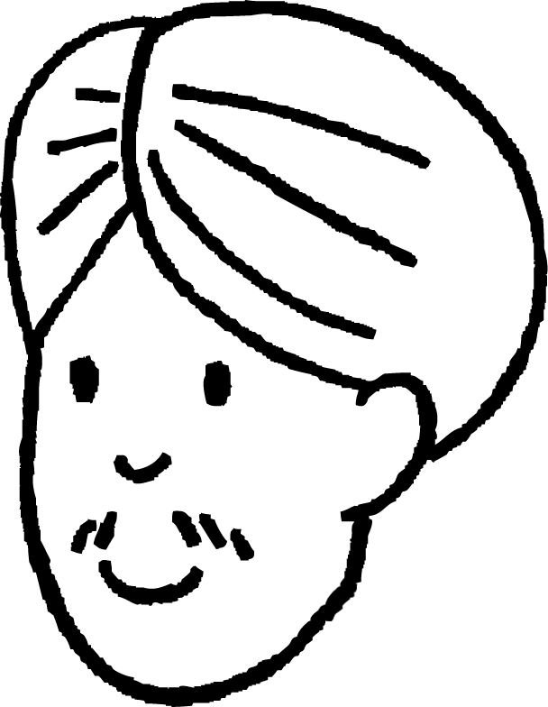
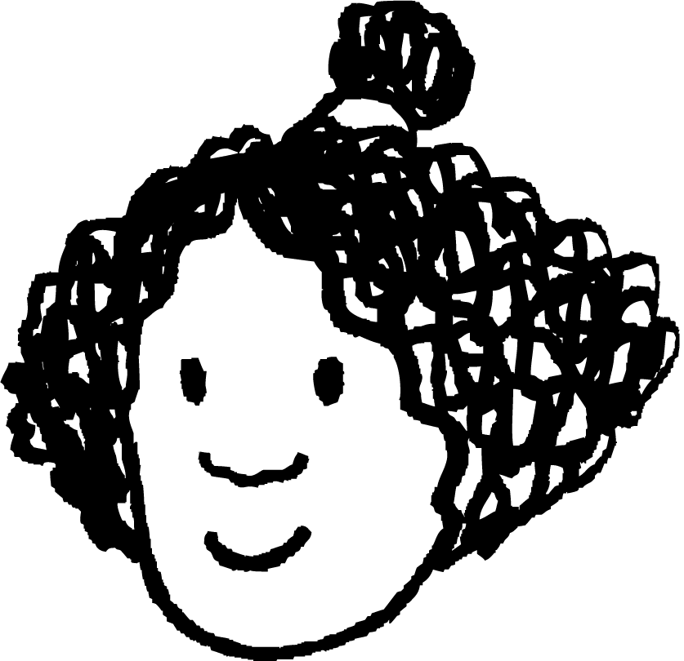
Using tangent from the unit circle
Andeep and Izzy are finding the value of x in the triangle.
We could use the unit circle to create a triangle where the adjacent has length 1 unit.
The opposite in this new triangle is now a tangent to the unit circle.
y
opposite
1
x cm
40°
40°
1
x
5 cm
O
1
adjacent

Slide 34
Using tangent from the unit circle
We can use this to find the length of the opposite for the triangle in the unit circle.
We could then use these proportions to find the value of x.
y
opposite
1
0.84
x cm
0.84
40°
40°
× 0.84
1
x
5 cm
O
1
× 0.84
adjacent

Slide 35
Using tangent from the unit circle
The tangent of an angle (0 ≤ θ ≤ 90) is the length of the opposite side, which lies on the tangent to the unit circle at (1, 0).
y
1
tan(θ)
opposite
θ°
θ°
O
1
1
adjacent
The tangent can be used to find either the opposite or adjacent in a right-angle triangle, when the other length and an angle is known.

Slide 36
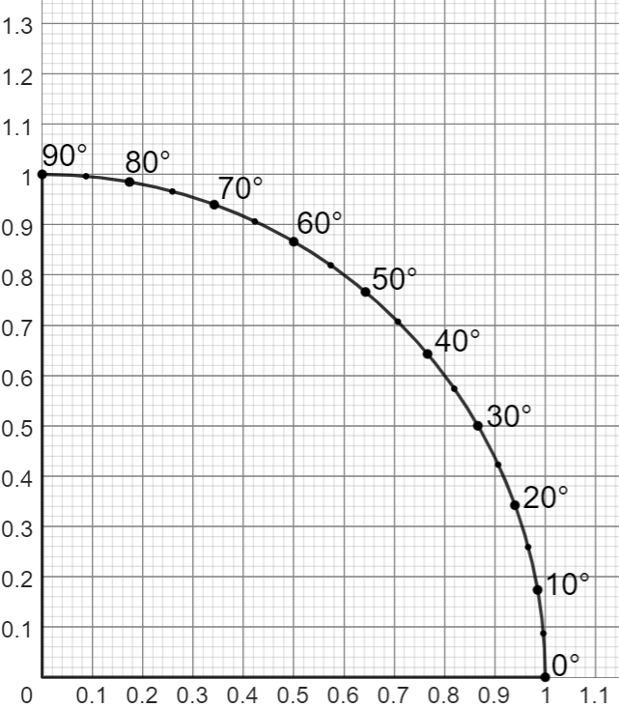
Using tangent from the unit circle
y
Example 1: Find the value of x.
adjacent
6 cm
opposite
40°
x cm
Label the sides.
We’re using the opposite and adjacent, so draw a tangent at x = 1.
x

Slide 37
Using tangent from the unit circle
y
Example 1: Find the value of x.
adjacent
6 cm
opposite
40°
x cm
opposite
Use the tangent to create a similar triangle.
40°
x
Check which edges correspond between the triangles.
adjacent

Slide 38
Using tangent from the unit circle
y
Example 1: Find the value of x.
adjacent
6 cm
opposite
40°
x cm
0.84
The adjacent in the unit circle has a length of 1 unit.
40°
The length of the opposite in this triangle is equal to tan(θ).
x
1

Slide 39
Using tangent from the unit circle
y
Example 1: Find the value of x.
adjacent
× 0.84
6 cm
opposite
40°
x cm
0.84
Use the same proportions to calculate the value of x.
40°
× 0.84
x = 6 × 0.84
x
= 5.04
1

Slide 40
Using tangent from the unit circle
y
What is the value of x?
x cm
30°
0.57
10 cm
x = 10 × 0.57
= 5.7
30°
x
1

Slide 41
Using tangent from the unit circle
1) Use this sector of the unit circle to find the value of each unknown.
y
a)
b)
a m
10 m
50°
50°
b m
10 m
c)
d)
4 m
20°
d m
c m
9 m
30°
Link to an interactive version: unit circle in first quadrant🖇
x

Slide 42
Using tangent from the unit circle
1) Use this sector of the unit circle to find the value of each unknown.
y
a)
b)
a m
10 m
50°
50°
b m
10 m
a = 11.9
b = 8.4
c)
d)
4 m
20°
d m
c m
9 m
30°
x
c = 3.3
d = 6.9

Slide 43
Scaling the right-angled triangle from the unit circle
There are specific ratios within the two key right-angled triangles defined by the unit circle.
One of the key right-angled triangles has a hypotenuse of length 1 unit. The opposite and adjacent sides of this triangle have lengths sin(θ) and cos(θ) respectively.
The other key right-angled triangle has an adjacent side of length 1 unit. The opposite side of this triangle has length tan(θ).
You can use similarity between any right-angled triangle and either key right-angled triangle to find missing lengths.

Slide 44

© Oak National Academy 2024.
Produced in partnership with Mathematics in Education and Industry.
Licensed on the Open Government Licence v3.0, except where otherwise stated. See Oak terms and conditions.

